Slide 1
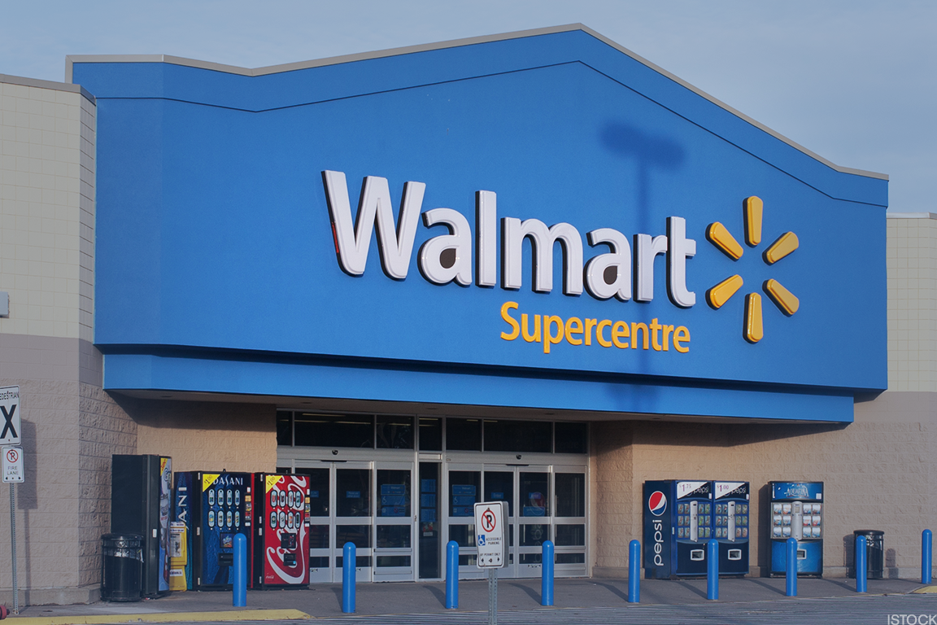
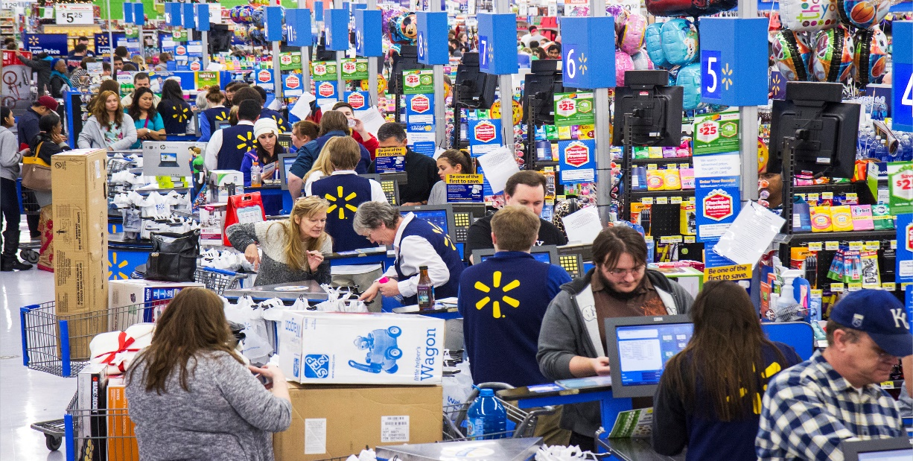
Analysis of Major KPIs for Walmart store sales
Pratik Samanta

Slide 2
Problem Statement
How different factors affect the sales figures of a Walmart Store by considering the factors like, item-weight, visibility, location of the store, type of outlet etc.
To develop a model that will help to find the potential customers by segmenting them on the basis of their purchase.
To find relationships between purchased items . The objective is to find the items which are having relations or the highest lifts.

Slide 3
Methodology of Data Collection
The whole data was collected from a secondary data source named Kaggle.com.
Types of data: secondary data

Slide 4
Sample Size
I have taken the Sales data of 322 Tier 3 Walmart stores for doing the regression analysis. It is a Convenience sampling.
I have taken 1200 transactions of 5 items of Walmart store for the market basket analysis.
I have taken 120 customer’s data from 4 different outlets of Walmart’s Tire 3 store for the RFM analysis for the segmentation of the customer based on their purchases.

Slide 5
Analytics Tool
Techniques used: Regression analysis , RFM analysis & market basket analysis.
Reasons for selecting the tools:
Regression analysis: In statistical modelling , regression analysis is a set of statistical processes for estimating the relationships among variables.
Market Basket Analysis: Market basket analysis seeks to find relationships between purchases. Our objective is to find the items which are having relations or the highest lifts.
RFM Analysis: It is based on the marketing axiom that 80% of your business comes from 20% of your customers. RFM helps to identify customers who are more likely to respond to promotions by segmenting them into various categories.

Slide 6
1. Factors affecting Walmart Store’s Sales:
 | Coefficients | Standard Error | t Stat | P-value
Intercept | -1115.27908 | 433.1387 | -2.57488 | 0.010482
Item_Weight | 77.75329799 | 37.37045 | 2.080609 | 0.038275
Item_MRP | 23.44323324 | 2.874958 | 8.154288 | 8.35E-15
MRP*Weight | -0.572373 | 0.24764 | -2.31131 | 0.021459
super type 3 | 1458.6703 | 155.0932 | 9.405122 | 1.1E-18
Grocery | -1702.744359 | 335.5174 | -5.07498 | 6.63E-07
Regression Statistics | Values
Multiple R | 0.760181199
R Square | 0.577875455
Adjusted R Square | 0.571196269
Standard Error | 1151.60122
Observations | 322

Slide 7
Findings From Regression
We have taken the factors like, Item fat content, Item type, MRP, Outlet size, Outlet type etc.
After the initial operation done by regression analysis, we have removes the factors which are having the p-value greater than 0.05.
The dependent variable is the sales figure (in monetary terms).
The independent variables are, Item fat content, Item type, MRP, Outlet size, Outlet type etc.
The final equation is,
Outlet_sales= {-1115.27908+ Item_Weight*77.75329799 + Item_MRP*23.44323324 - (MRP*Weight)* 0.572373 + super type 3*1458.6703 - Grocery*1702.744359}
*We have introduced one interaction variable named MRP*Weight.

Slide 8
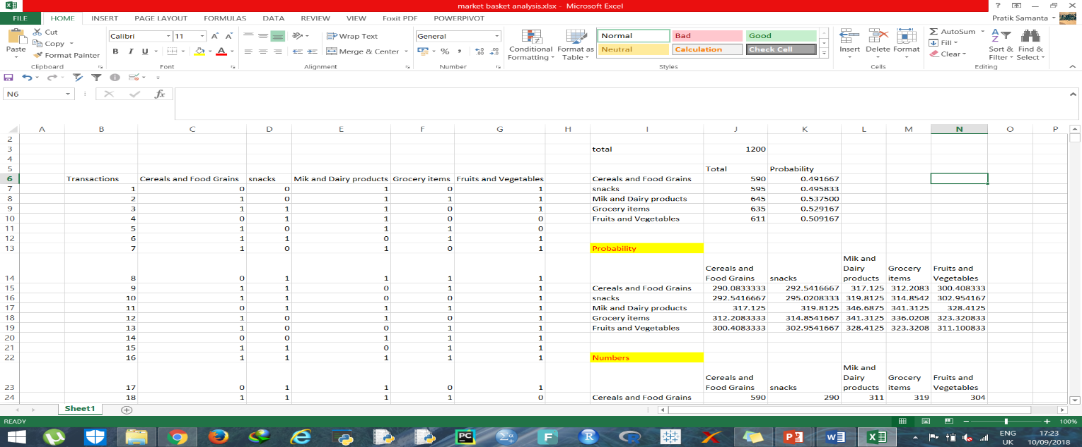
2. Market Basket Analysis of Walmart Store’s items:
Total Transactions | 1200
 | Total Numbers | Probability
Cereals and Food Grains | 590 | 0.491667
snacks | 595 | 0.495833
Mik and Dairy products | 645 | 0.537500
Grocery items | 635 | 0.529167
Fruits and Vegetables | 611 | 0.509167
Lift Calculation
 | Cereals and Food Grains | snacks | Mik and Dairy products | Grocery items | Fruits and Vegetables
Cereals and Food Grains | 2.033898305 | 0.991311779 | 0.980686 | 1.021754 | 1.01195595
snacks | 0.991311779 | 2.016806723 | 1.013094 | 0.978231 | 1.00015129
Mik and Dairy products | 0.980685849 | 1.01309361 | 1.860465 | 1.013734 | 0.9713394
Grocery items | 1.021753637 | 0.98458281 | 1.022523 | 1.889764 | 1.01756511
Fruits and Vegetables | 1.011955949 | 1.013354605 | 0.989609 | 1.017565 | 1.96399345

Slide 9
Findings From Market Basket Analysis
The highest 3 lifts are,
Milk and dairy products with Grocery items. Lift obtained is = 1.022523
Grocery items with Cereals and food grains. Lift obtained is = 1.021754
Grocery items with Fruits and vegetables. Lift obtained is = 1.017565
Decision:
We can say that these items can be kept together for making more sales of the products. If you buy a certain group of items, you are more (or less) likely to buy another group of items.

Slide 10
3. Segmentation of Customers of Walmart with the help of Purchases history:
Row Labels | Count of Grade category Outlet1
A | 6
B | 4
C | 8
D | 7
E | 5
Grand Total | 30
Row Labels | Count of Grade category Outlet1
Loyal Customer | 6
Potential Loyalist | 4
Need Attention | 8
At Risk | 7
Switchers | 5
Row Labels | Count of Grade category Outlet2
A | 9
B | 4
C | 3
D | 8
E | 6
Grand Total | 30
Row Labels | Count of Grade category Outlet2
Loyal Customer | 9
Potential Loyalist | 4
Need Attention | 3
At Risk | 8
Switchers | 6

Slide 11
Continued..
Row Labels | Count of Grade category Outlet3
A | 8
B | 4
C | 4
D | 8
E | 6
Grand Total | 30
Row Labels | Count of Grade category Outlet3
Loyal Customer | 8
Potential Loyalist | 4
Need Attention | 4
At Risk | 8
Switchers | 6
Row Labels | Count of Grade category Outlet4
A | 5
B | 5
C | 7
D | 7
E | 6
Grand Total | 30
Row Labels | Count of Grade category Outlet4
Loyal Customer | 5
Potential Loyalist | 5
Need Attention | 7
At Risk | 7
Switchers | 6

Slide 12
Findings From RFM Analysis

Slide 13
Continued..

Slide 14
Continued..

Slide 15
Continued..
Decision:
In outlet 2 & Outlet 3 the loyal customers are more according to the RFM Score.

Slide 16
THANK YOU

